Slide 1
Strategy, Organization Design, and Effectiveness
Organization Theory and Design
Eleventh Edition
Richard L. Daft
©2013 Cengage Learning. All Rights Reserved. May not be scanned, copied or duplicated, or posted to a publicly accessible website, in whole or in part.

Slide 2
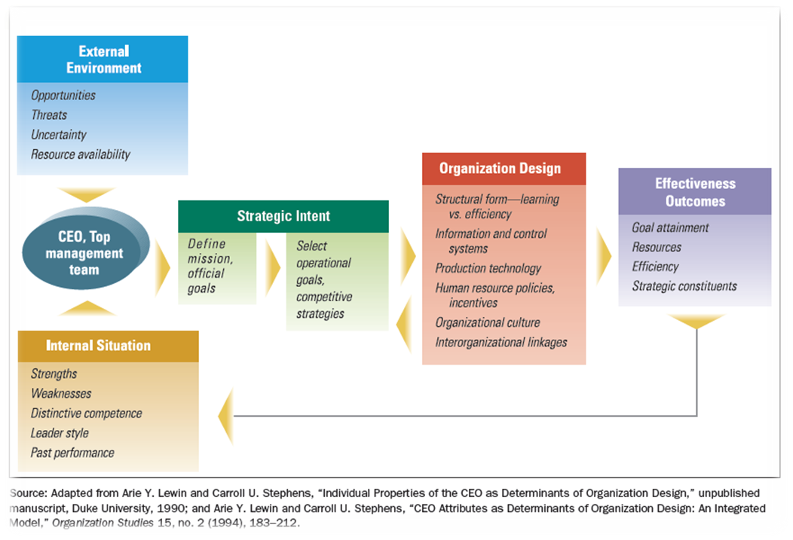
Strategy Direction and Organization Design
Organizational goal - a desired state of affairs that an organization attempts to reach
©2013 Cengage Learning. All Rights Reserved. May not be scanned, copied or duplicated, or posted to a publicly accessible website, in whole or in part.

Slide 3
Organizational Purpose
Strategic intent - organization’s energies and resources are directed toward a focused, unifying, and compelling goal
Operating Goals
Overall Performance
Resources
Market
Employee Development
Innovation and Change
Productivity
Mission
Competitive Advantage
Core Competence
©2013 Cengage Learning. All Rights Reserved. May not be scanned, copied or duplicated, or posted to a publicly accessible website, in whole or in part.

Slide 4
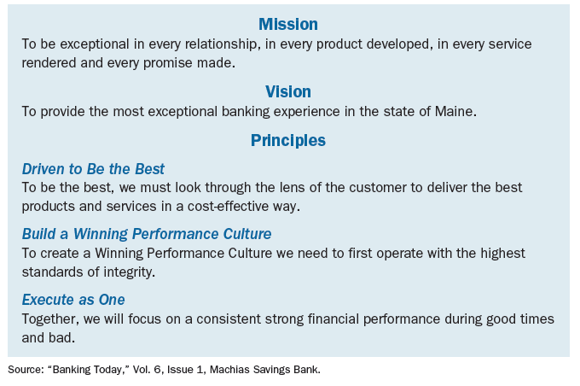
Mission Statement for
Machias Savings Bank
©2013 Cengage Learning. All Rights Reserved. May not be scanned, copied or duplicated, or posted to a publicly accessible website, in whole or in part.

Slide 5
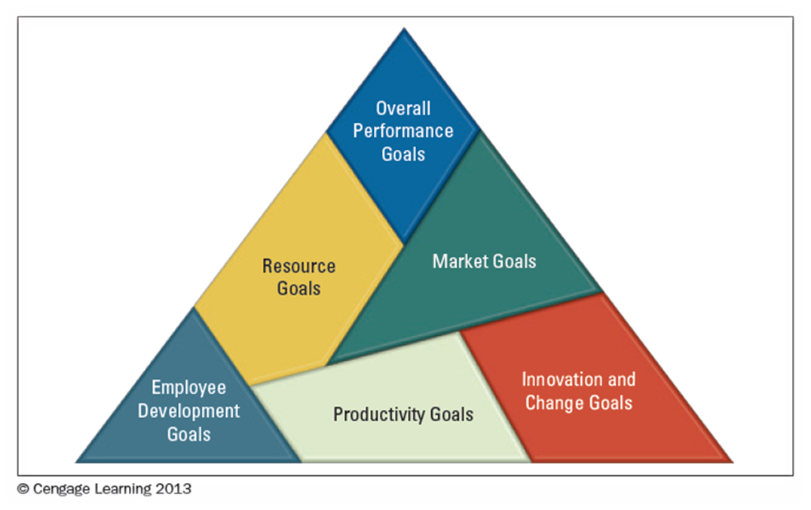
Organizational Operating Goals
©2013 Cengage Learning. All Rights Reserved. May not be scanned, copied or duplicated, or posted to a publicly accessible website, in whole or in part.

Slide 6
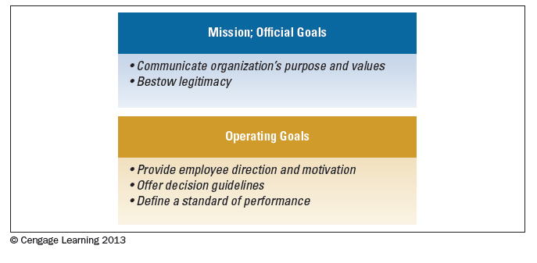
The Importance of Goals
©2013 Cengage Learning. All Rights Reserved. May not be scanned, copied or duplicated, or posted to a publicly accessible website, in whole or in part.

Slide 7
Selecting Strategy and Design
A strategy is a plan for interacting with the competitive environment
Managers must select specific strategy design
Models exist to aid in formulating strategy:
  Porter’s Five Forces
  Miles and Snow’s Strategy Typology
©2013 Cengage Learning. All Rights Reserved. May not be scanned, copied or duplicated, or posted to a publicly accessible website, in whole or in part.

Slide 8
Porter’s Competitive Strategies
Differentiation strategy – to distinguish products or services from others in the industry
Low-Cost Leadership – increase market share by keeping costs low compared to competitors
Organizations may choose to focus broad or narrow in reaching multiple markets.
©2013 Cengage Learning. All Rights Reserved. May not be scanned, copied or duplicated, or posted to a publicly accessible website, in whole or in part.

Slide 9
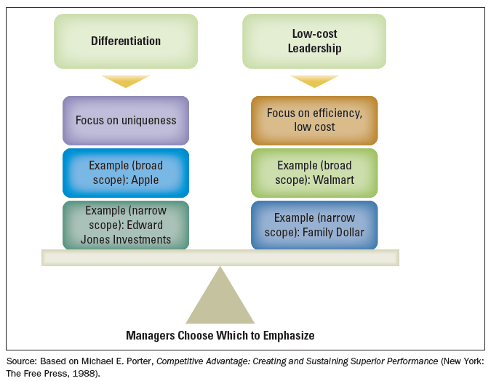
Porter’s Competitive Strategies
©2013 Cengage Learning. All Rights Reserved. May not be scanned, copied or duplicated, or posted to a publicly accessible website, in whole or in part.

Slide 10
Miles and Snow’s
Strategy Typology
Managers should seek to formulate strategy that matches the demands of the external environment
Prospector
  Learning orientation; flexible, fluid, decentralized structure
  Values creativity, risk-taking, and innovation
Defender
  Efficiency orientation; centralized authority and tight cost control
  Emphasis on production efficiency, low overhead
Analyzer
  Balances efficiency and learning; tight cost control with flexibility and adaptability
  Emphasis on creativity, research, risk-taking for innovation
Reactor
  No clear organizational approach; design characteristics may shift abruptly depending on current needs
©2013 Cengage Learning. All Rights Reserved. May not be scanned, copied or duplicated, or posted to a publicly accessible website, in whole or in part.

Slide 11
How Strategy Affects
Organization Design
Managers must design the organization to support the firm’s competitive strategy
Strategy impacts internal organization characteristics
©2013 Cengage Learning. All Rights Reserved. May not be scanned, copied or duplicated, or posted to a publicly accessible website, in whole or in part.

Slide 12
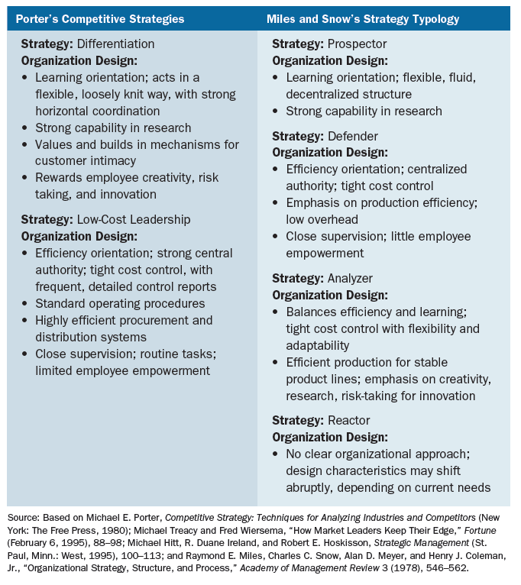
Organization Design Outcomes of Strategy
©2013 Cengage Learning. All Rights Reserved. May not be scanned, copied or duplicated, or posted to a publicly accessible website, in whole or in part.

Slide 13
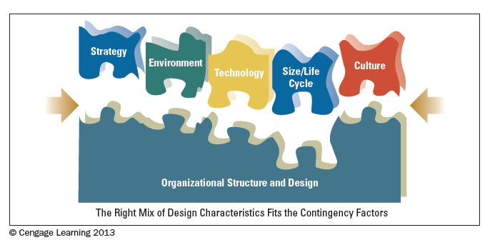
Contingency Factors
Affecting Organization Design
©2013 Cengage Learning. All Rights Reserved. May not be scanned, copied or duplicated, or posted to a publicly accessible website, in whole or in part.

Slide 14
Assessing Organizational Effectiveness
Effectiveness takes into consideration a range of variables at both the organizational and departmental levels.
Efficiency relates to the working of the organization and amount of resources used to produce output.
Measuring Effectiveness:
  The Goal Approach
  The Resource-Based Approach
  The Internal Process Approach
  The Strategic Constituents Approach
©2013 Cengage Learning. All Rights Reserved. May not be scanned, copied or duplicated, or posted to a publicly accessible website, in whole or in part.

Slide 15
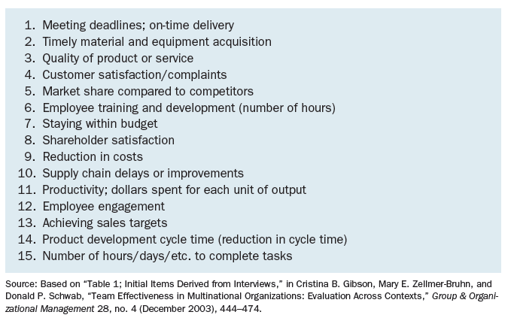
Indicators of Organizational Effectiveness
©2013 Cengage Learning. All Rights Reserved. May not be scanned, copied or duplicated, or posted to a publicly accessible website, in whole or in part.

Slide 16
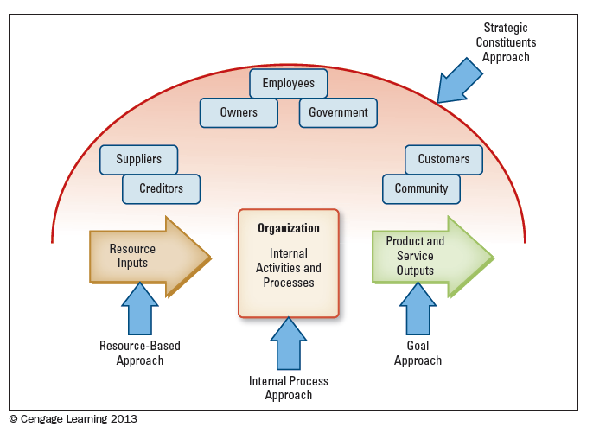
Approaches to Measuring
Organizational Effectiveness
©2013 Cengage Learning. All Rights Reserved. May not be scanned, copied or duplicated, or posted to a publicly accessible website, in whole or in part.

Slide 17
An Integrated Effectiveness Model
Competing values model tries to balance concern with various parts of the organization
The human relations emphasis incorporates the values of an internal focus and flexible structure
©2013 Cengage Learning. All Rights Reserved. May not be scanned, copied or duplicated, or posted to a publicly accessible website, in whole or in part.

Slide 18
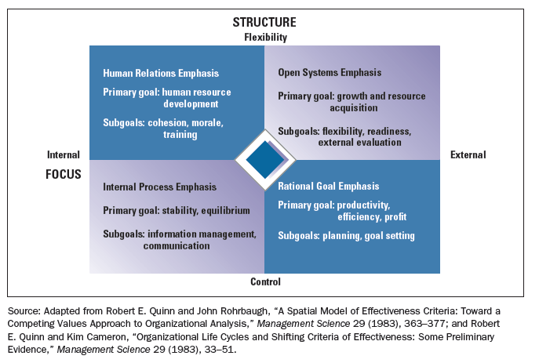
Four Approaches to
Effectiveness Values
©2013 Cengage Learning. All Rights Reserved. May not be scanned, copied or duplicated, or posted to a publicly accessible website, in whole or in part.

Slide 19
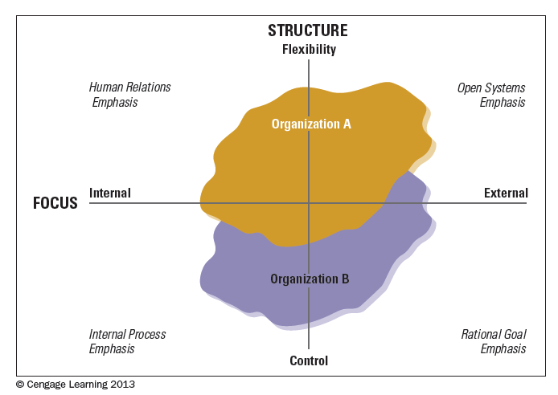
Effectiveness Values for
Two Organizations
©2013 Cengage Learning. All Rights Reserved. May not be scanned, copied or duplicated, or posted to a publicly accessible website, in whole or in part.

Slide 20
Design Essentials
Organization exist for a purpose
Strategic intent includes competitive advantage and core competence
Strategies may include many techniques
There are models to aid in the development of strategy
Organizational effectiveness must be assessed
No approach is suitable for every organization
©2013 Cengage Learning. All Rights Reserved. May not be scanned, copied or duplicated, or posted to a publicly accessible website, in whole or in part.

